Slide 1
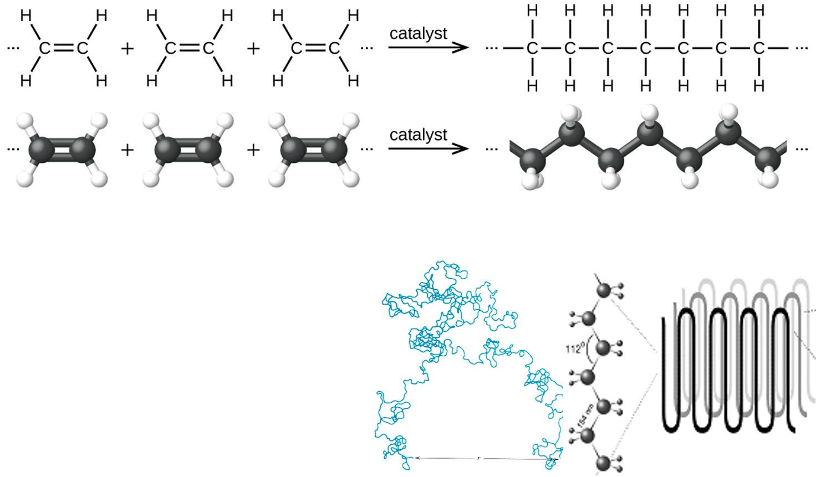
Polyethylene: Structure-Property-Processing
Planar zig zag
https://opentextbc.ca/chemistry/chapter/20-1-hydrocarbons/
At temperatures above T_{g} (-110 ºC) the C-C-C bonds rotate freely with a bond angle of 112˚ and H-C-H at 107˚thus chains can from random coils of amorphous regions or highly ordered folded chains (crystalline regions).

Slide 2
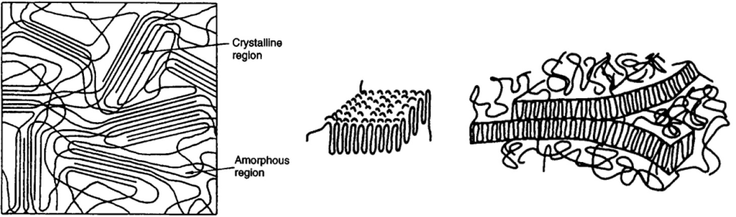
Crystalline and Amorphous structures
The fringed micelle model
Semicrystalline polymers
Polymer crystals are always separated from each other by amorphous regions. Thus a crystalline polymer is really partly crystalline and partly amorphous, thus more correct to call it semicrystalline.
Non-crystalline polymers (amorphous)
glassy polymers, such as polystyrene, PMMA and polycarbonate, polymers known for their transparency.
elastomers, or rubbers, such as polyisoprene, or butyl rubber, often filled with particles to increase their stiffness and resistance to wear, making them opaque.
Notes:
Picture from www.nottingham.ac.uk/~emzddf/polymerengineerin
Model of Crystallites (Morphology)
Elastomers are amorphous polymers existing above their glass transition temperature.
Examples of elastomers include natural rubbers, styrene-butadiene block copolymers, polyisoprene, polybutadiene, ethylene propylene rubber, ethylene propylene diene rubber, silicone elastomers, fluoroelastomers, polyurethane elastomers, and nitrile rubbers. Various copolymer technologies continue to bring new elastomers to the market. Applications of elastomers include soft touch overmolds, gaskets, seals, and rubber septums.

Slide 3
Crystalline and Amorphous structures
PE contains large numbers of heterogeneous nuclei – e.g. from catalyst residues or trapped foreign particles (Nucleating agent)
On cooling from the melt – lamellae crystals (thin crystals) grow from the edges of the crystal plates. Thus expand laterally to several microns while thickness of the lamella plate remains at 10 - 15 nm.
The folded chain model
(Engineering with Polymers, Powell)
Lamella form next to it at slight angle mismatch and wheat sheaf structure forms until a spherulite is completed
Between lamellae are most of the chain branches and intercrystalline line, these links prevent lamellae from sliding over each other.

Slide 4
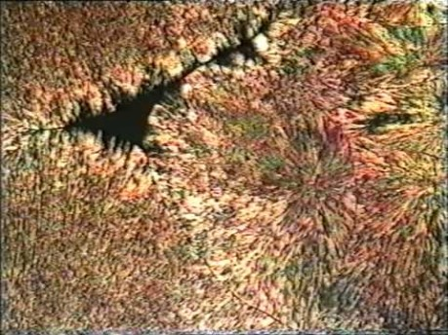
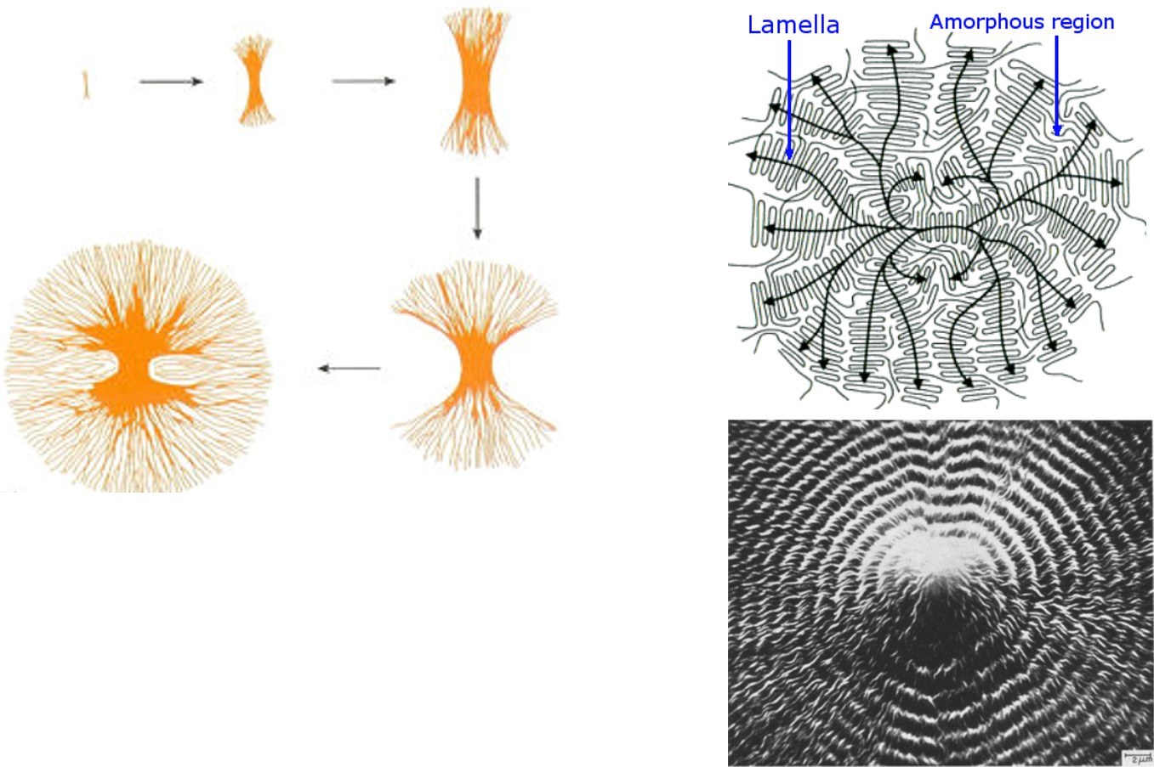
Polyethylene: Structure-Property-Processing
Video: Spherlulite growth
Growth of spherulites:
Branching and splaying of lamella form the mechanisms of three dimensional growth into spherulites.
The spherulite volume is inversely proportional to number of nuclei.
Too high a melt temperature destroys nuclei while rapid cooling (supercooling) increases the number of nuclei, radial growth rate for HDPE~ 5000 μm min⁻¹
By The Open University, C Hall, released under CC BY-NC-SA 2.0 license SEM of PE spherulites, Breedon et al. J Mater Sci (1973) 8: 1071.
Notes:
Better picture of amorphous

Slide 5
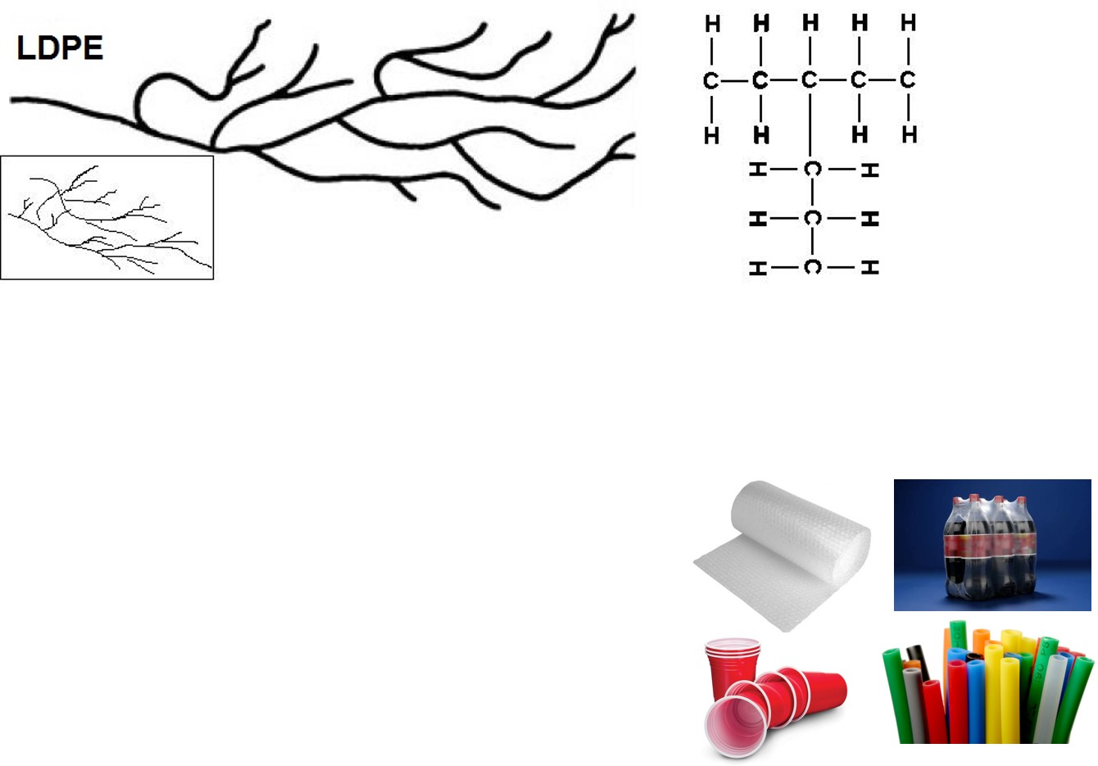
Polyethylene: Structure-Property-Processing
Low density Polyethylene ( LDPE)
Density 915 - 925 kg m⁻³ M_{w} up to 50,000 g/mol
processed under high pressure (1-2 kbar) and temperature (100 – 300 ˚C).
very branched molecules reducing the rapid arrangement of molecules during crystallisation.
low crystallinity (40-65%),
T_{m} ~ 110 ˚C, T_{g} ~ -120˚C
Applications: Films, bags, transparent parts,
packaging, bubble wrap, flexible caps

Slide 6
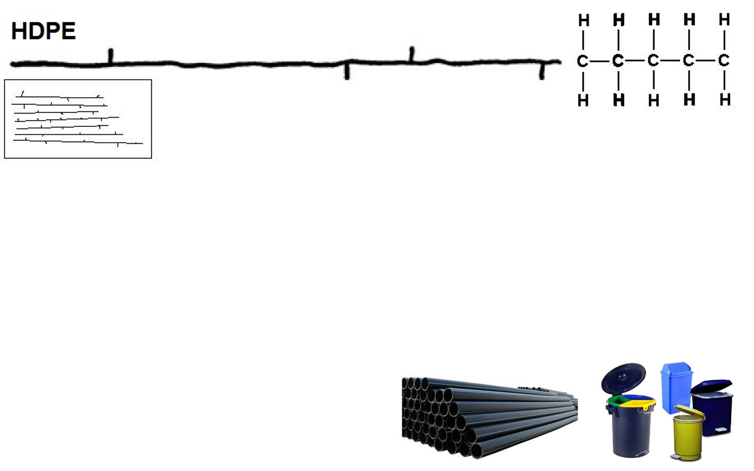
Polyethylene: Structure-Property-Processing
High density polyethlene (HDPE)
Density 945 - 960 kg m⁻³ M_{w} up to 200,000 g/mol
Processed at lower pressure (30 bar) and temperatures (40 – 150 ˚C)
long linear chains with limited number of short-chain branching
high crystallinity (85-95%),
T_{m} ~ 130 ˚C, T_{g} ~ -120˚C
Applications: Pipes, pails, covers,
chemical containers, jars, tanks…

Slide 7
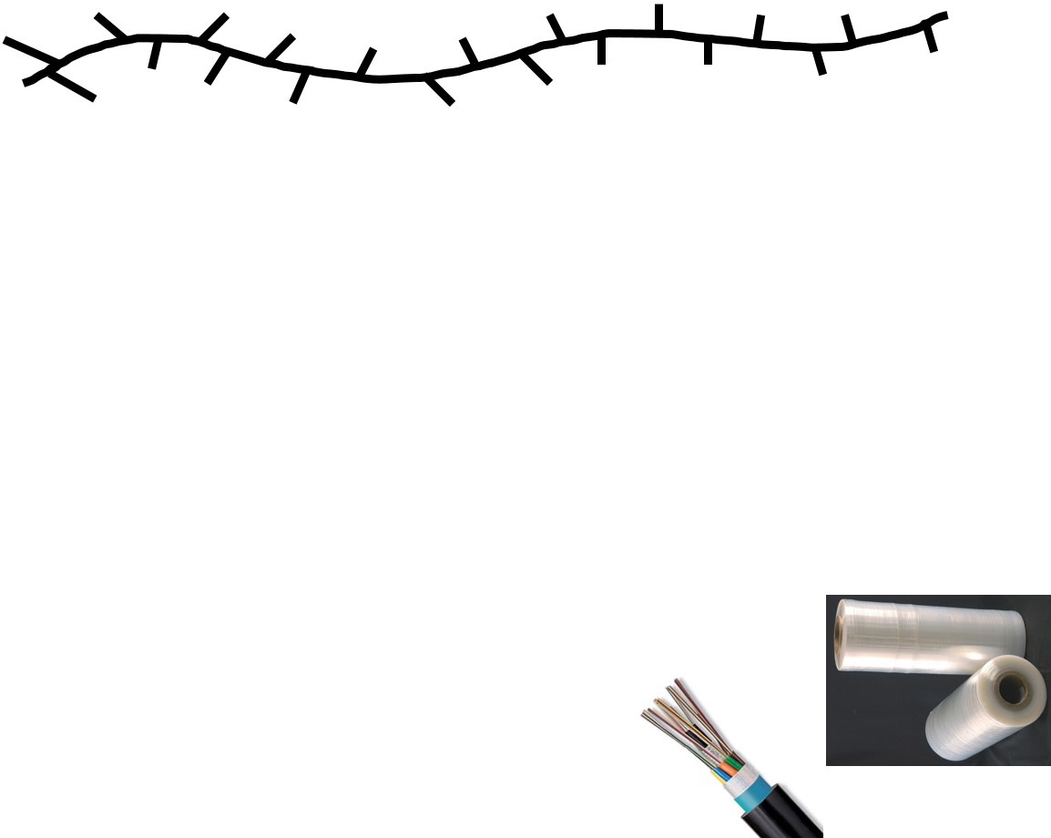
Polyethylene: Structure-Property-Processing
LLDPE
Linear low density polyethylene(LLDPE)
Density 910 – 925 kg⁻³ and M_{w} up to 50,000 g/mol
Processed at lower temperatures than LDPE
mostly linear chains with significant numbers of short branches
low crystallinity (20 - 35%),
T_{m} ~ 124 ˚C, T_{g} ~ -70˚C
Advantages: Higher tensile strength, impact and puncture resistance than LDPE and lower thickness films can be blown with environmental stress cracking resistance.
Applications: packaging, particularly film for bags
and sheets due to its toughness, flexibility and
relative transparency, Other applications include
cable covering, toys, lids, buckets, containers and pipe.

Slide 8
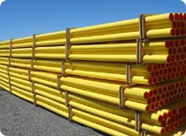
Polyethylene: Structure-Property-Processing
MDPE
Medium density polyethylene(MDPE)
Density 926 – 940 kgm⁻³ M_{w} up to 50,000 g/mol
Processed by mechanical mixing of LDPE and HDPE
intermediate properties between LDPE and HDPE
can be also polymerised directly using a range of catalysts ( e.g. chromium/silica)
Advantages: its shock and drop resistance and
stress cracking resistance are better than HDPE.
Applications: engineering applications
such as water and gas pipes as well as
sacks, shrink film, packaging film, carrier bags

Slide 9
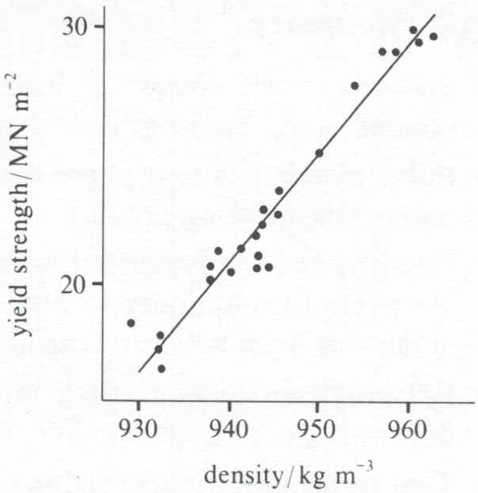
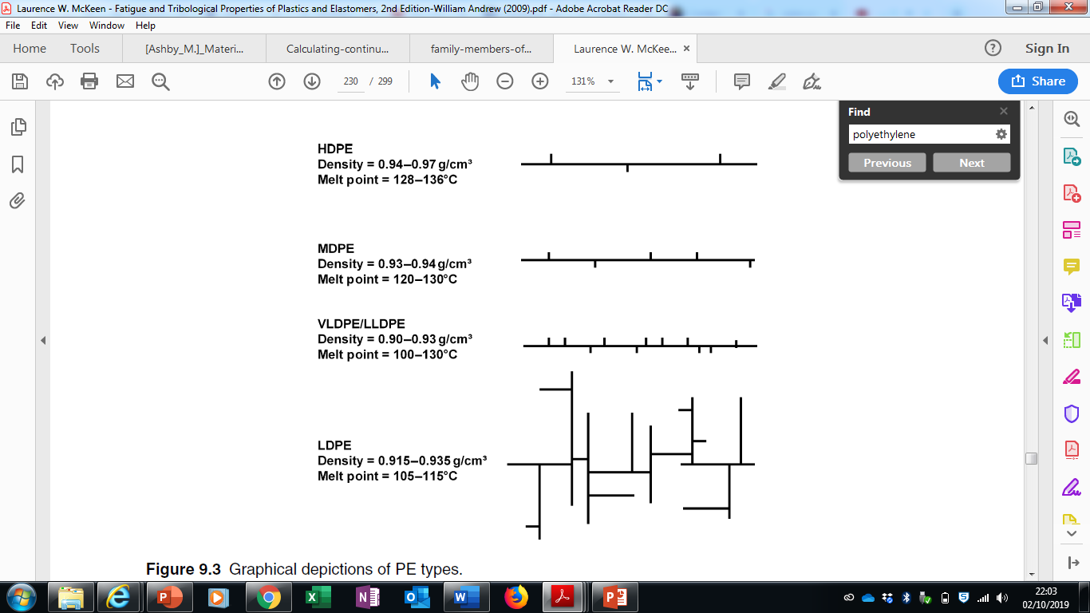
Its not just about density
Variation of yield strength with density for various grades of PE
But what about molecular weight?
Consider UHMWPE…..

Slide 10
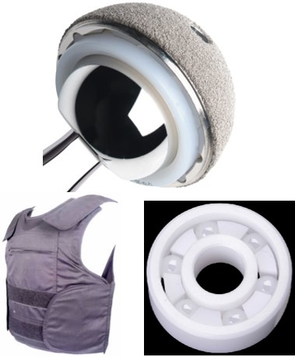
Polyethylene: Structure-Property-Processing
Ultra high molecular weight polyethylene (UHMWPE)
Density 930 – 940 kg m⁻³ and M_{w} up to 6 Million g/mol
Processed at lower pressure (6 bar) and temperatures (66 – 90 ˚C)
Linear long chains with very little branching, typically < 2%
Crystallinity ~ 45%
T_{m} 132 - 138˚C, T_{g} ~ -150˚C
Advantages: high toughness, the yield strength, improved abrasion and chemical resistance, resistance to impact and cyclical failure, higher hardness and a low coefficient of friction.
However, its Melt Flow Index is very low and cannot
be processed by conventional injection moulding,
blow moulding or extrusion. Instead it has to be
processed by compression moulding or machining.
Applications: Ideal for bearing surface in biomedical
implants, also used in marine barriers, rods, pumps
and bearings, gaskets and protective armour vests.

Slide 11
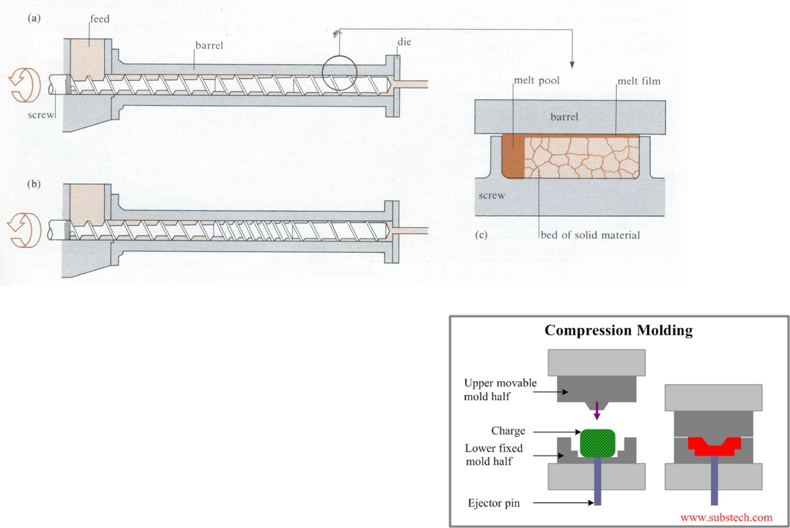
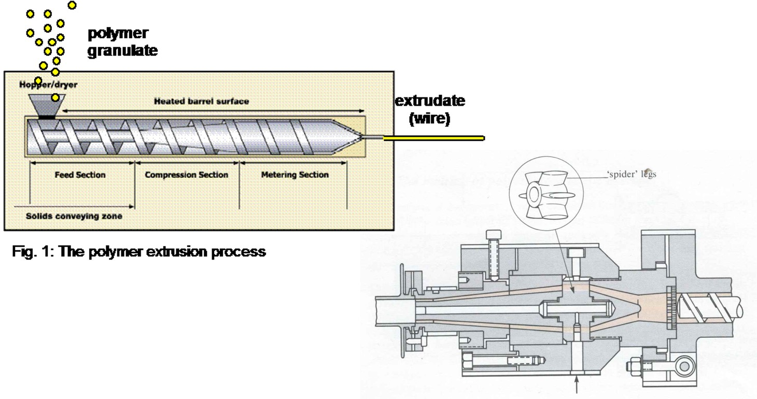
Polyethylene: Structure-Property-Processing
Polymers can be melt processed into complex products using techniques such as Extrusion, Injection Moulding and Compression Moulding
Typical die for producing tube
wire
Video : Plastic melt processing

Slide 12
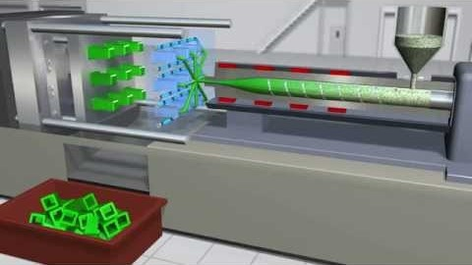
Polyethylene: Structure-Property-Processing
Video : Plastic melt processing

Slide 13
Polyethylene: Structure-Property-Processing
The melting processing
As the granules are conveyed forward by the screw the melt pool and film extends until at the end of the screw all is melted.
This distance or residence time is critical as you require the polymer to minimise its time at high temperature to avoid degradation…

Slide 14
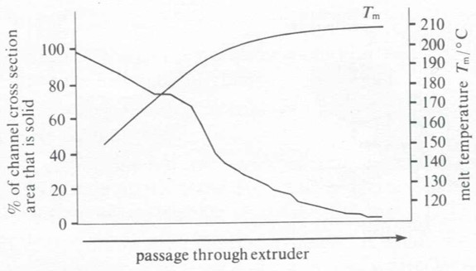
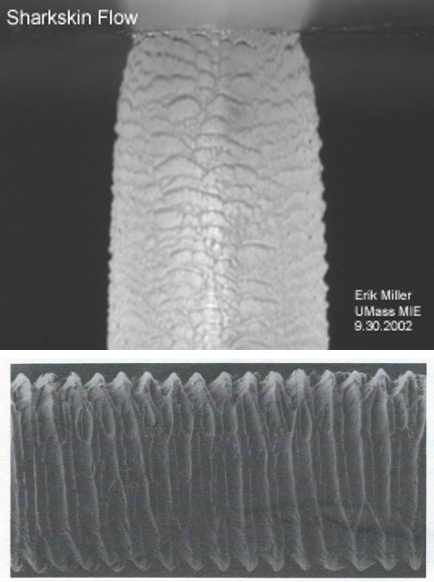
Polyethylene: Structure-Property-Processing
Extruder Processing – Property considerations
If screw speed too fast - insufficient residence time to melt the polymer, can lead to melt fracture as a result of instability due to slip of the melt at the die walls. This leads to roughened surfaces, “sharkskin surfaces”
For PE the melt emerging from the die should be 200 - 220˚C to give a smooth surface.
If screw speed too slow - excessive temperatures through viscous heating will degrade the polymer by oxidation.

Slide 15
Polyethylene: Structure-Property-Processing
Extruder Processing – Property considerations
The extruders are designed to allow “drag flow” to dominate, that is flow due to the screw motion.
There is a pressure drop which is proportional to h³/η where h is the channel depth, which gives “pressure flow”.
The design of the extruder should make pressure flow to be less than 10%.
To maintain temperature - cooling is needed. Some self regulation as the viscosity and therefore viscous heating reduces with increasing temperature.
Increasing the molecular weight of PE will lead to higher viscous heating, influencing the extruder design and factors such as screw speed.
Total flow = Drag flow - Pressure flow
Notes:
Pure drag flow where the velocity at the top of the channel equals the velocity of the barrel relative to the screw and the bottom is zero velocity as the resin is stuck to the screw. When the head pressure is introduced, the drag flow is still there, but the head pressure is causing a backward flow near the bottom of the channel. The net flow is a combination of the drag flow minus the pressure flow.

Slide 16
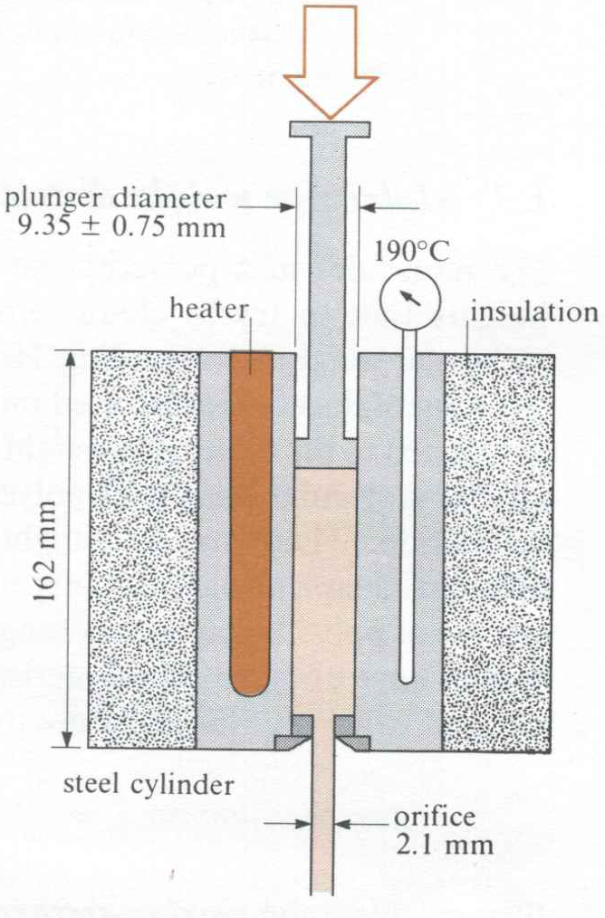
Polyethylene: Structure-Property-Processing
Melt Flow Index(MFI)
Ability of material melt to flow under a pressure (ISO 1133), Inverse of melt viscosity.
A method to determine melt viscosity of polymers, in this case polyethylene.
Using the exact dimensions in the figure the MFI is the output in grams when a 2.16 kg mass is used to extrude the polyethylene at 190ºC.
Range is typically 0.01 for high viscosity high molecular weight polymers and 50 for easy flowing injection mould grades.

Slide 17
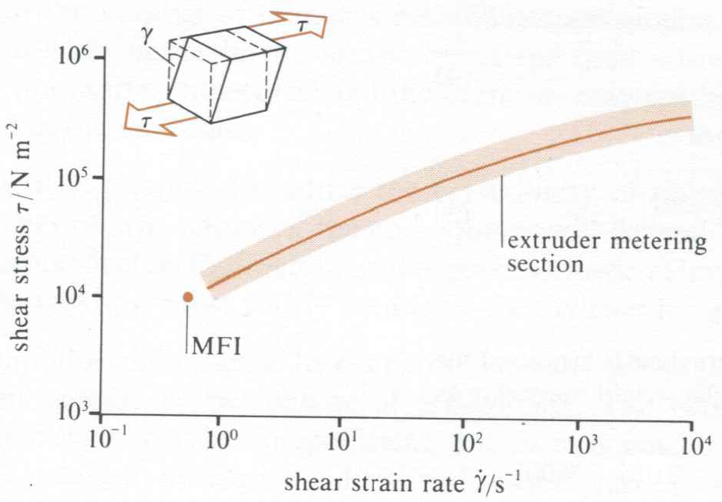
Polyethylene: Structure-Property-Processing
Melt Flow Index
Many factors affect polymers’ flow properties such as molecular weight distribution, the presence of co-monomers, the degree of chain branching and crystallinity as well as heat transfer.
Also the shape of a melt flow curve of shear stress versus shear strain rate depends on molecular weight distribution.
Notes:
Discuss average molecular weight …sketch on board different distributions of similar average molecular weight

Slide 18
PQ2 Polymer Question 2
PE like most polymers has a low thermal conductivity,
k ≈ 0.2 W m⁻¹K⁻¹.
Therefore relying on conventional sensible heat to reach temperature would take a long time for the process. However the high viscosity of the polymer can allow viscous heating (represents transformation of shear forces into heat) to occur.
Calculation A: Calculate the energy to heat 1 cm³ MDPE of density 0.94 g cm⁻³ from 20 to 200˚C assuming a heat capacity of 2365 J kg⁻¹ K⁻¹.
Calculation B: How much energy input is provide by a shear rate of 100 s⁻¹ delivered over 40 s on 1 cm³ of PE ?
(hint: use the figure on previous slide) ?
Notes:
When a viscous fluid in a slit is set in flow by a large imposed pressure gradient, a vast amount of mechanical energy is converted irreversibly into heat owing to the fluid’s internal friction. This viscous heat dissipation not only leads to an overall increase in the fluid’s bulk temperature but also causes a noticeable temperature variation to develop across the shear field.

Slide 19
PQ2 Answer
Answer A:
Quantity of heat Q = c m ΔT = 2365 x 940 x 10⁻⁶ x 180 = 400 J
400 J is required to heat 1 cm³ of MDPE from 20 to 200ºC.
Answer B:
Shear stress (τ) on the top surface of MDPE cube (1cm³) would move it by ϒ in 1 s.
Therefore, the power dissipated by viscous heating per unit volume is P = τ ϒ (wm⁻³)
From shear stress-strain graph, at 100 s⁻¹ the shear stress is 10⁵ Nm⁻²
Energy per unit volume is
E = P t = τ ϒ t = 10⁵ x 100 x 40 = 4 x 10⁸ J m⁻³ = 400 J cm⁻³
Notes:
In this case, strain energy per unit mass = shear stress x shear strain =F/A x dx/L = (F/LxL) x (dx/L) and L = 1, so strain energy per unit volume = F x dx
Power = work done (J)/time
P=F/A=F⋅d/A⋅d=W/V=Energy/V

Slide 20
Pipe Internal environment- Natural Gas
Natural ( North Sea) Gas |  | Volume%
Methane | CH₄ | 92.3
Ethane | CH₃-CH₃ | 3.5
Nitrogen | N₂ | 3.1
Propane | CH₃-CH₂-CH₃ | 0.9
Butane | CH₃-CH₂-CH₂-CH₃ | 0.2
Carbon Dioxide | CO₂ | Trace
Natural gas is mostly methane plus other hydrocarbon gases plus conditioning agents that are added to protect parts of the network that still may be cast iron.

Slide 21
Gas Leakage
CAST IRON
U.S. cast iron distribution mains are estimated to have leaked 250 billion litres of natural gas in 2007. This equates to $150 million worth of gas.
Or of the Fugitive methane emissions from distribution mains account for 32% of methane emissions from the U.S. natural gas distribution sector. Cast iron pipelines contribute the most to these emissions, despite representing only 3% of of the U.S. distribution mains
Pipeline and Gas Journal,2009 Vol. 236 No. 9
Notes:
Fugitive emissions are losses, leaks and other releases of methane to the atmosphere that are associated with industries producing natural gas, oil and coal.

Slide 22
Gas Leakage
CAST IRON PIPES
Typically leakage is 7500 l km⁻¹ yr⁻¹. Leaks tend to develop in the packing over time due to heavy overhead traffic, freeze-thaw cycles, naturally shifting soil, and the switch to dryer natural gas.
PE PIPES
Methane diffuses through PE pipes. So how does PE pipe diffusion losses compare with the leakage with cast iron leaks

Slide 23
PQ3 Polymer Question 3
Question: Calculate the volume of methane gas diffusing through a 1 km pipe in a year. Use
where K is the permeability coefficient, A is area of pipe surface, t is the wall thickness and T is time
In your calculation assume a 90 mm OD pipe diameter of wall thickness 8.5 mm and the pressure in the pipe to be 1 bar g (bar gauge), and K for the PE pipe to be 0.075 mm² bar⁻¹ day^{-1.}
Notes:
Absolute pressure = Gauge Pressure + atmospheric pressure (1bar) = 2 bar
Permeability coefficient is the transport flux of material through the material per unit driving force per unit membrane thickness

Slide 24
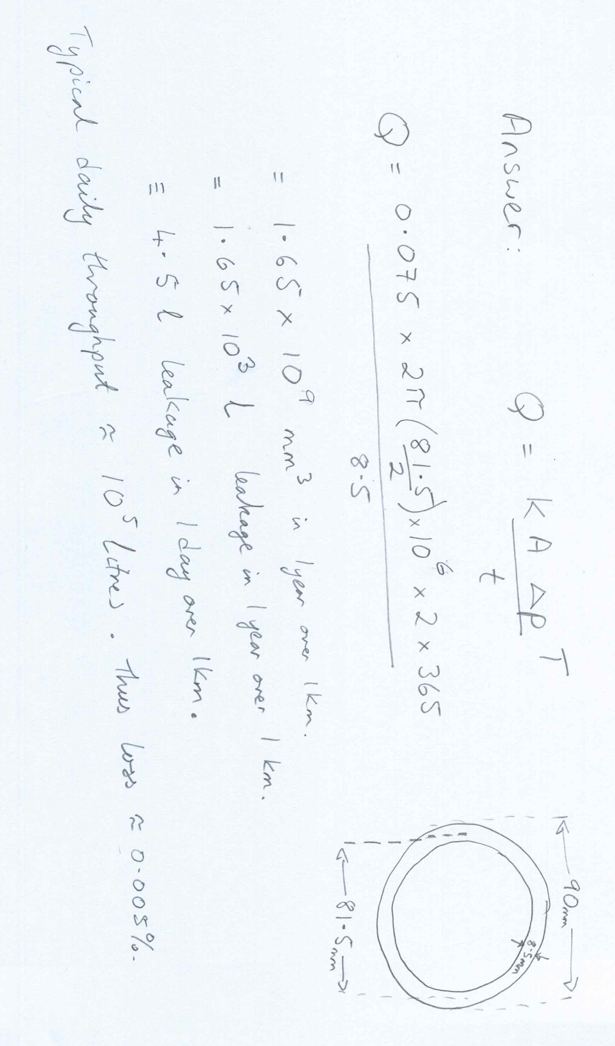
Answer

